Slide 1
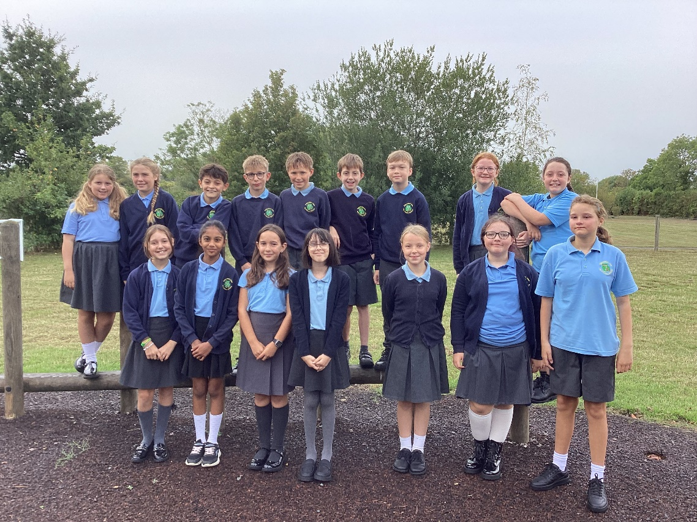
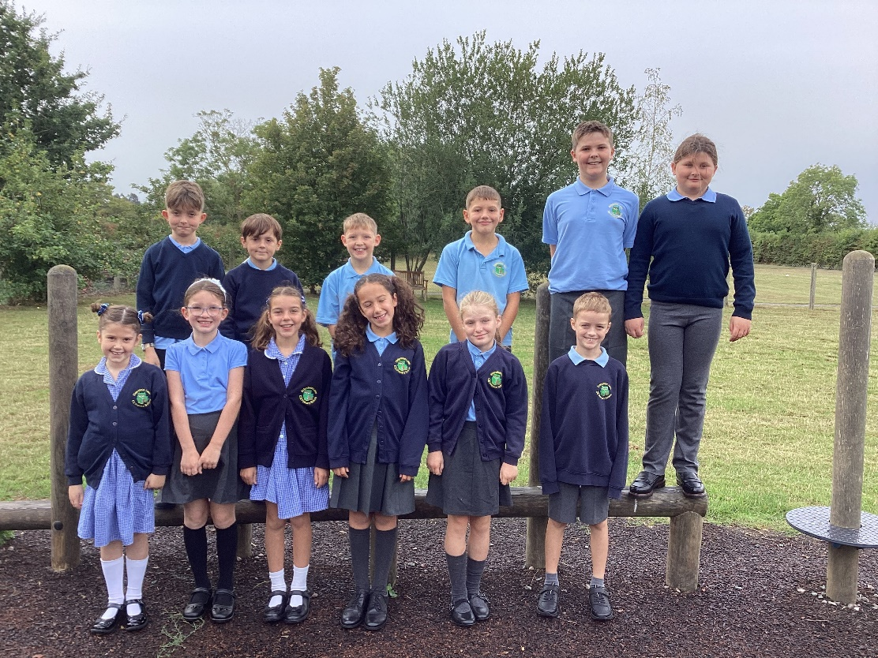
Welcome to Class 4’s Curriculum Evening.
Teachers: Mrs Carolan (Monday, Tuesday).
Mrs George (Wednesday, Thursday, Friday)
TAs - Mrs Phelps (Monday – Thursday, Mrs Evans - Friday)

Slide 2
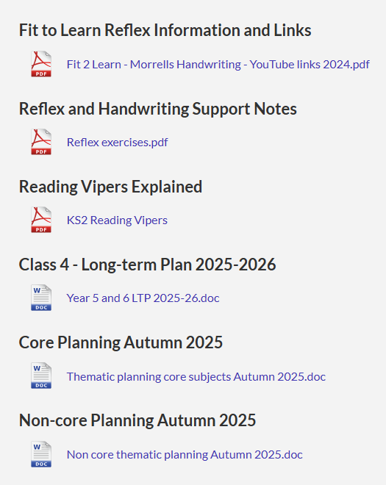
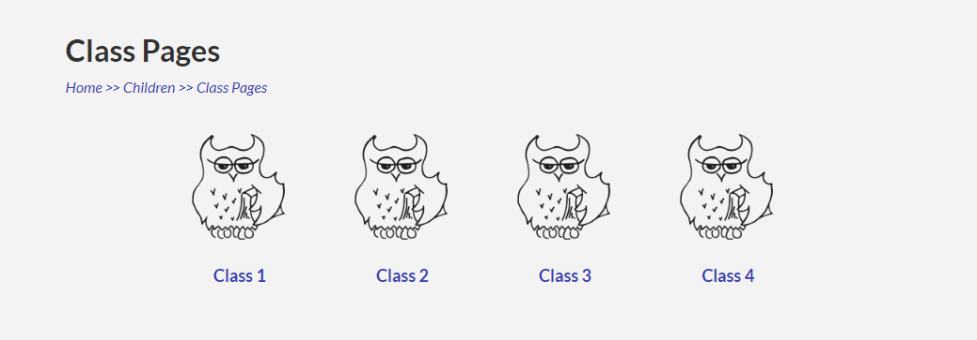
School Website
Please be patient as the school transfers to a new umbrella company. We’ve had a lot of headaches so far!
Please could you check information daily before phoning the school.
Class 4 Page (We will upload photos).
Using email for correspondence (paperless).

Slide 3
Housekeeping
Emails before 8.15am - ecarolan@eldersfieldlawn.worcs.sch.uk
(Monday, Tuesday) sgeorge@eldersfieldlawn.worcs.sch.uk (Wednesday,Thursday,Friday)
Curriculum Web– on Year 4 class page
PE Kit – In school at all times. Trainers for outdoor use and warm tracksuit please. Swimming kit on Thursday
Start of School – 8.35am spellings/tables practise. Please be prompt.
End of school - 3.15pm.
Healthy Snacks –Fruit only please. Water to drink.
Absence Request –Via the school office and Head- teacher

Slide 4
Uniform
Uniform – smart, shirts tucked in.
Labelled – label jumpers
Girls – hair tied back. Stud earing only. No hair accessories please.
Boys – neat haircuts.
Shoes - Comfortable black shoes that are waterproof.

Slide 5


Reading – 20 minute Pledge
The school will read to your child for at least 10 minutes a day.
Can you match it at home please?
The single biggest impact you can have on your child’s education is listening to them read. Please use the questions at the front of their reading record to help you (reading Vipers).
Please fill in and sign your child’s reading record. The children will be asked to bring their reading record into school everyday and it will be checked on Friday. Every 5 signatures, children receive a raffle ticket for the monthly non-uniform draw.

Slide 6
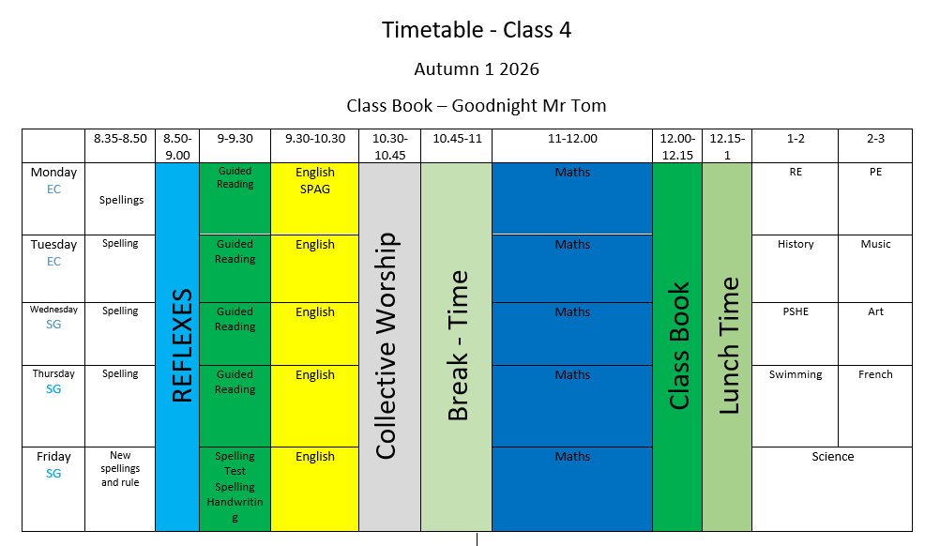

Slide 7
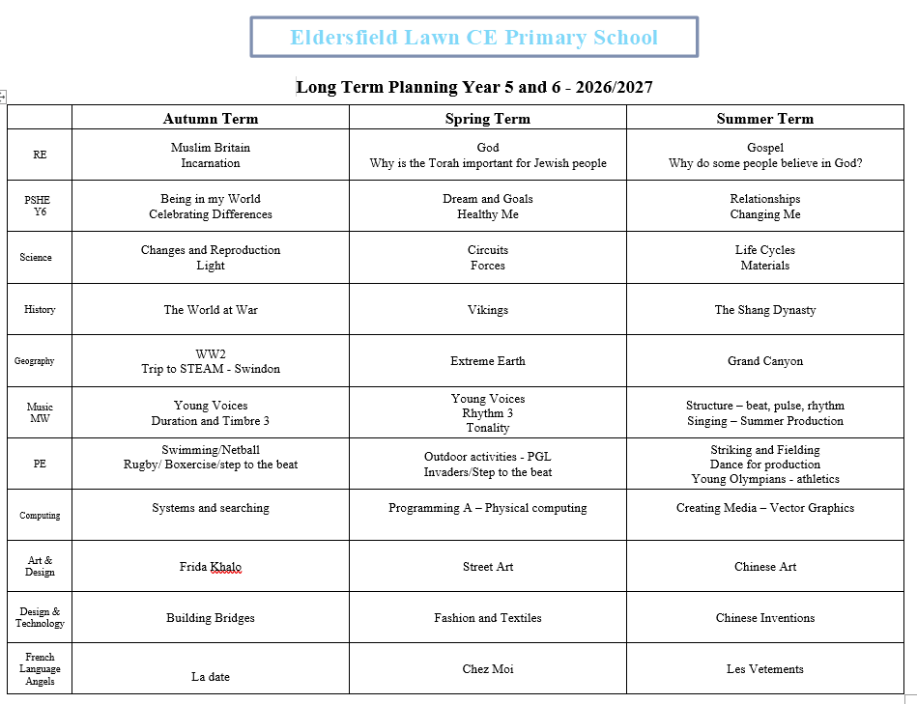

Slide 8
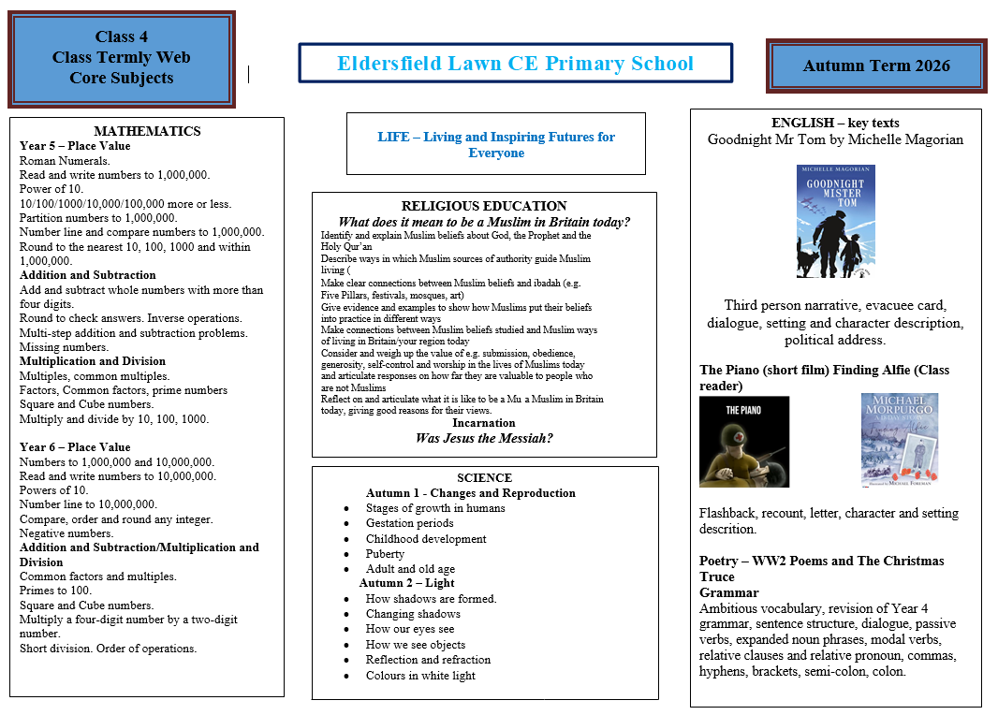

Slide 9
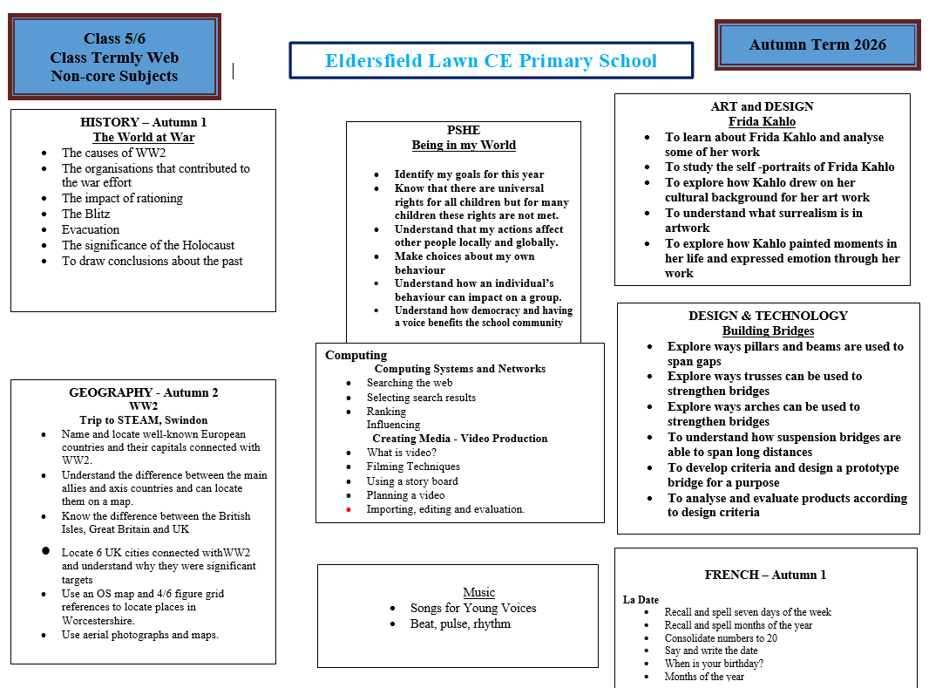

Slide 10
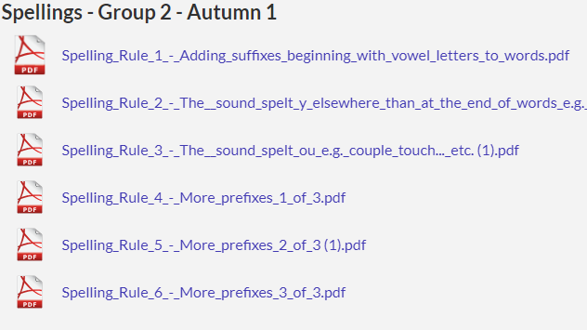
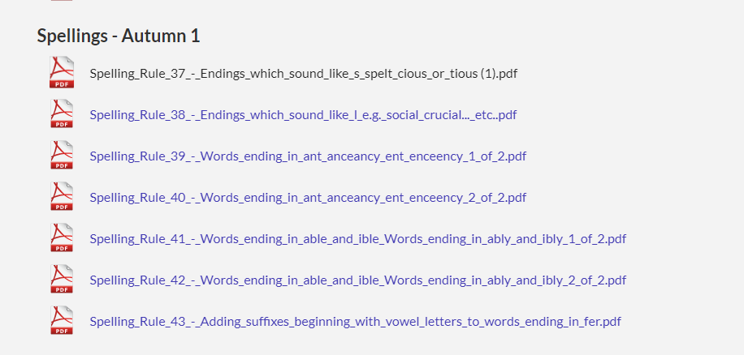
Spellings
Spelling rule input – Friday
Activities throughout the following week – 08.35am
Daily home learning
Spelling test every week (5 spellings out of each 10)
Spellings on class page

Slide 11
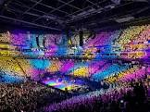
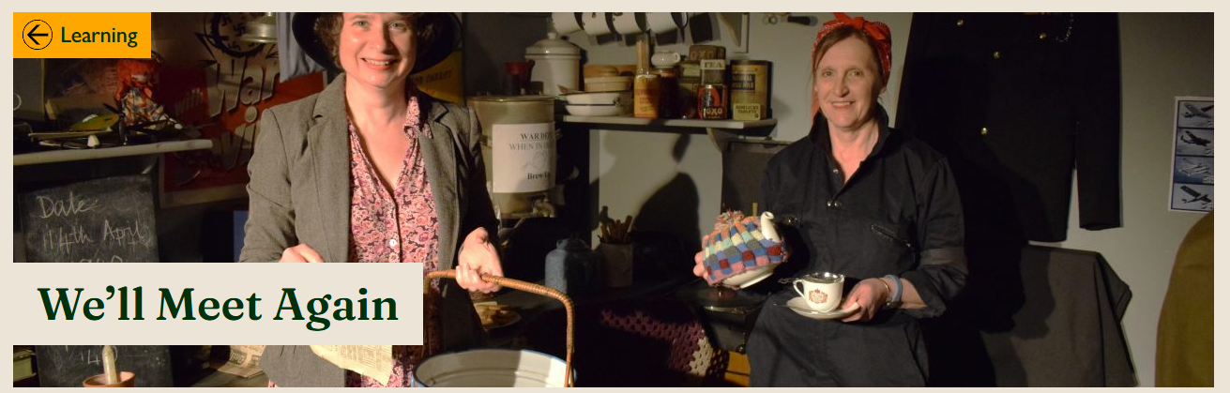
Trips
Cheltenham Literature Festival – Thursday 15th October – Katherine Rundell, Hannah Gold.
Trip to STEAM at Swindon – Tuesday 29th September
Malvern Cross Country –Friday 2nd October.
Young Voices (Jan).
PGL - 2027
London - 2027

Slide 12
Diary Dates
PTFA AGM – Thursday 24th September at 6.30pm at The Hunters Inn,
Longdon – all welcome.
Harvest Festival – Thursday 1st October - 9am Eldersfield Church
Coffee and collection afterwards.
Parents Evenings – Wednesday 7th October 3.30-5.30pm
Thursday 8th October 1.15pm-4.30pm
This is a time to discuss how your children is settling in to their new year
group.

Slide 13

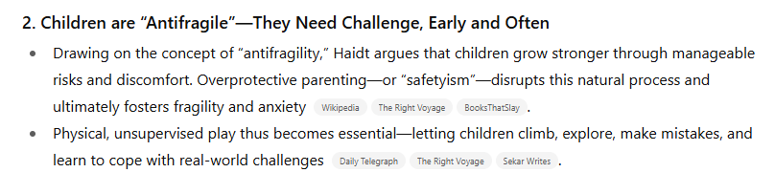
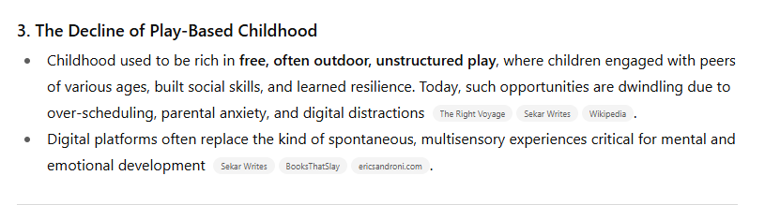
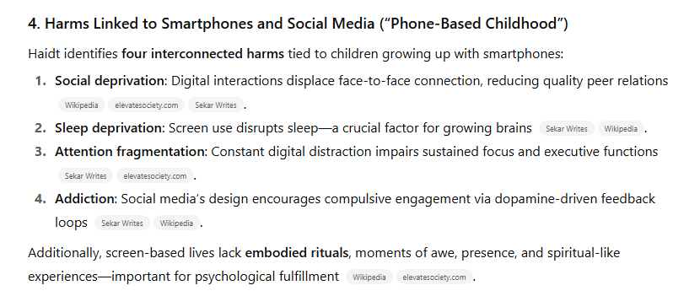
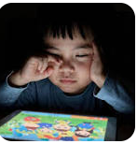

Slide 14

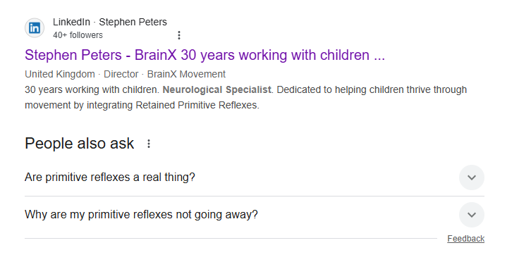

Primitive Reflexes
https://www.brainxmovement.com/

Slide 15
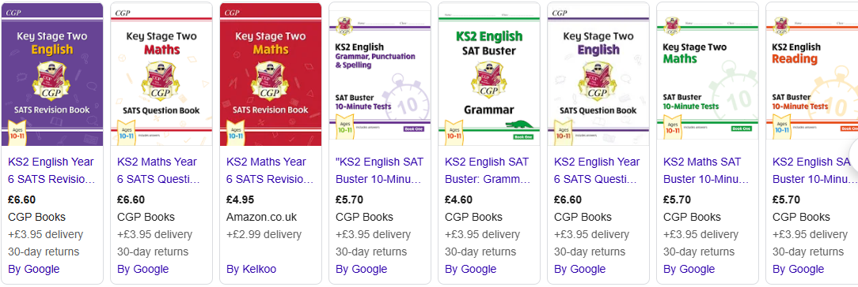
SATs 2027
Monday 10th May – Thursday 13th May 2026
Monday 11th – English grammar, punctuation and spelling.
Tuesday 12th – English Reading
Wednesday 13th – Maths
Thursday 14th – Maths
Homework will commence after Christmas but if you would like to start sooner,
please use Year 5 resources as revision, as the children will not have been taught the
Y6 Curriculum.

Slide 16

Concerns
Please email us straight away
Both parents’ and children's worries are important.
Please do not leave it – however small.

Slide 17
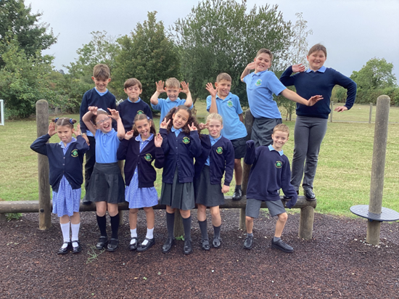

Any questions?
Thank you and we look forward to teaching your children and getting to know them.

