Slide 1
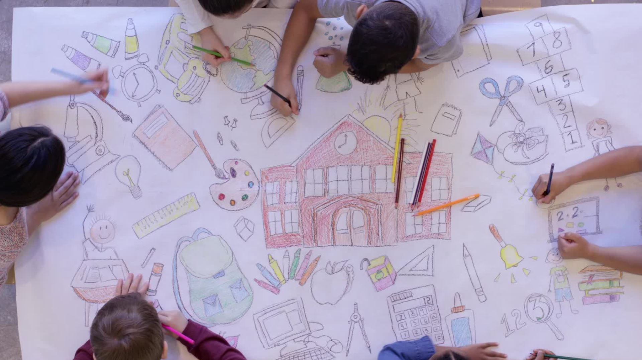
Eldersfield Lawn
C of E Primary School
A Vision for the Future

Slide 2
Context
Graded Outstanding in 2012
No OFSTED inspection since
Since 2012
  New National Curriculum
  Three New Inspection Frameworks
  Nationally recognised levels of progress
  Recognition through Primary School of the Year awards.

Slide 3
Core responsibilities
Ensure that children are safe and happy
01
Ensure that learning and teaching is world class
02
Embed a lifelong love of learning
03

Slide 4
Ensure that children are happy and safe
Effectiveness of Safeguarding protocols
  Update policies to KCSiE 2022
  Update all staff training
  External audit of current procedures and SCR
  At school and home.
Wellbeing - BBC (2022) reports 77% increase in the number of serious referrals in education.
  What can be done?
Cost of living crisis.
  Close monitoring.
  Community hub, supporting families and children

Slide 5

Safeguarding
Anti Bullying Policy
Attendance and Behaviour Policy
Safe Recruitment Policy
Low Level Concerns Policy
Whistleblowing Policy
Safeguarding and Child Protection Policy
Acceptable Use of Technology Policy
Relationships Policy
Social Media Policy
Child on Child Abuse Policy
PREVENT Policy
Exclusion Policy

Slide 6
Further developments
CPOMS
Further opportunities to enhance the Pupil Voice
  Junior Governors
  Monitors
  SLT Meetings
  Pupil Surveys
  Open door policy – trusted adults

Slide 7
Ensure that Learning and teaching are world class
Every child has the right to a quality education that builds upon previous learning.
Best possible outcomes for every child by developing processes to individualise learning.
  Adapted outcomes
  Lessening the gap through effective assessment
Increase every child's potential
Relevance of progress measures – Professor Dylan William
  There’s no doubt that the higher the education level you have, the more you earn during your life, the longer you will live and the better your quality of life. For society, the benefits are also huge. There are lower criminal justice costs; by increasing the level of education, you reduce the amount of money spent on incarcerating people.

Slide 8
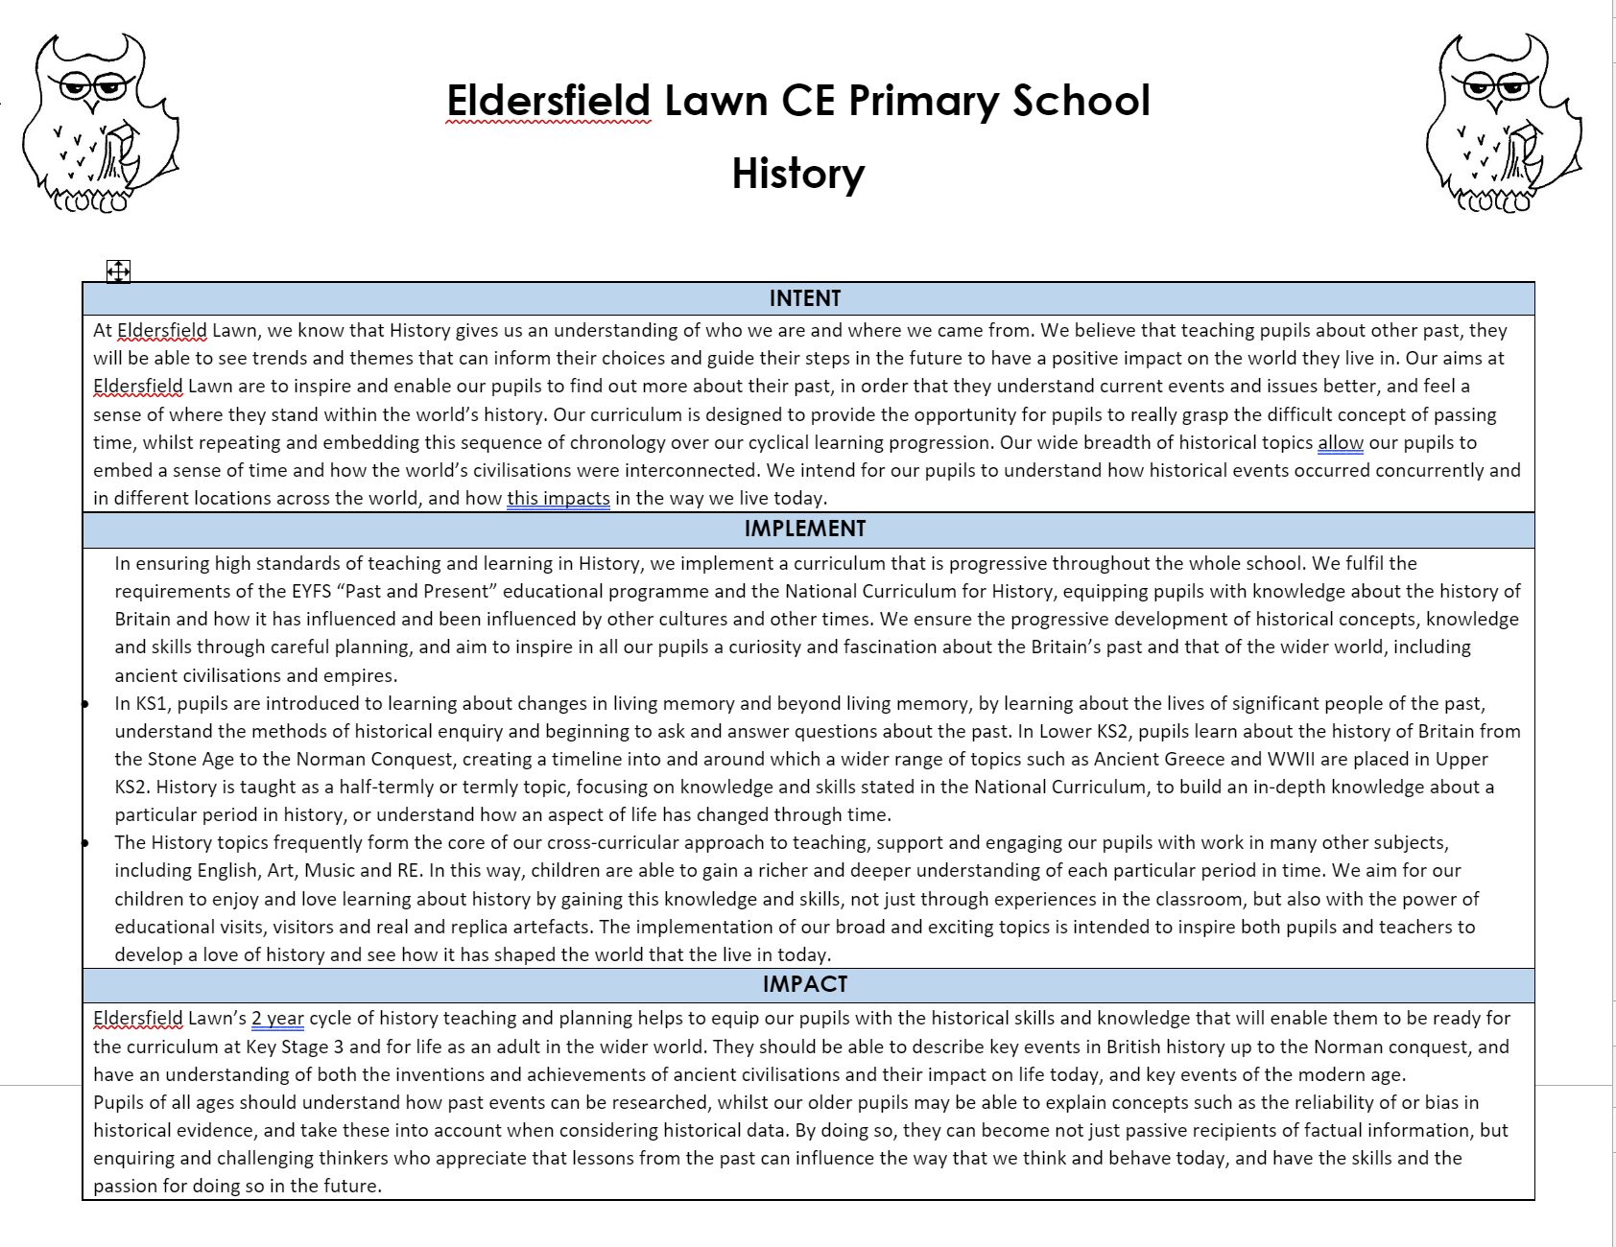

Slide 9
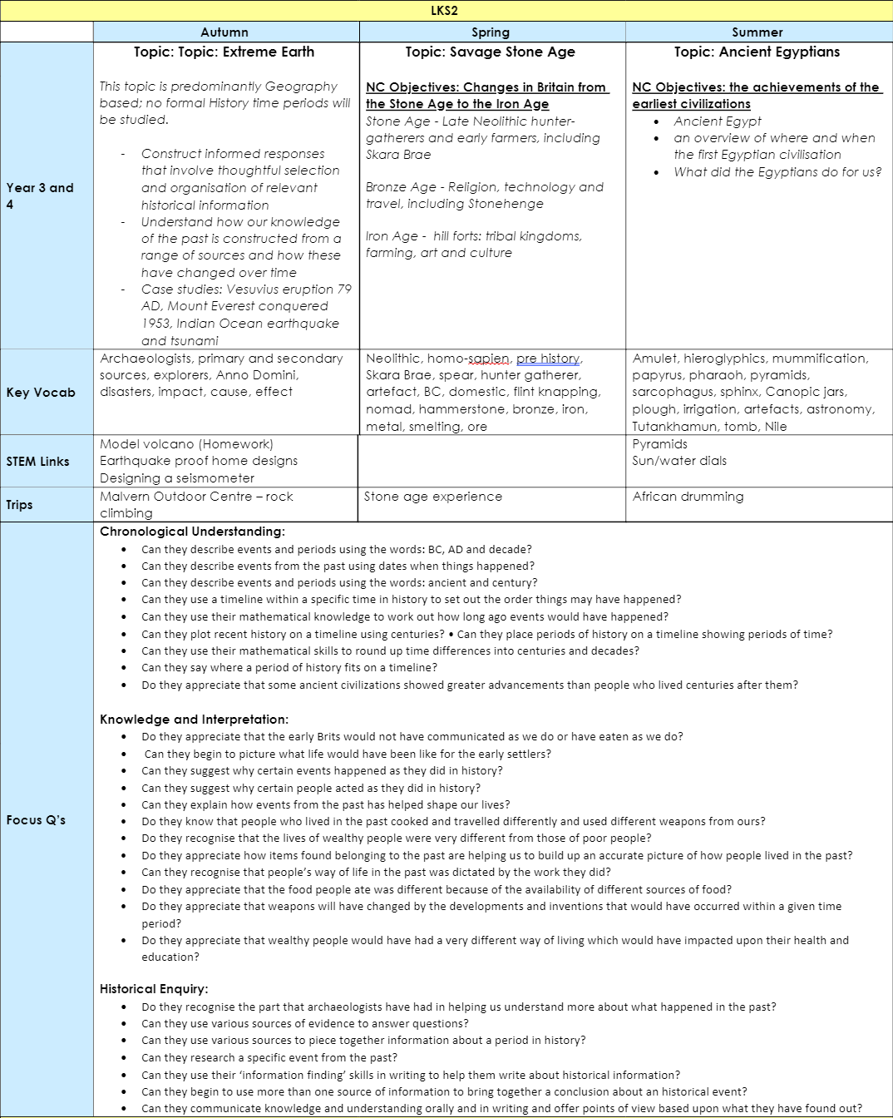

Slide 10
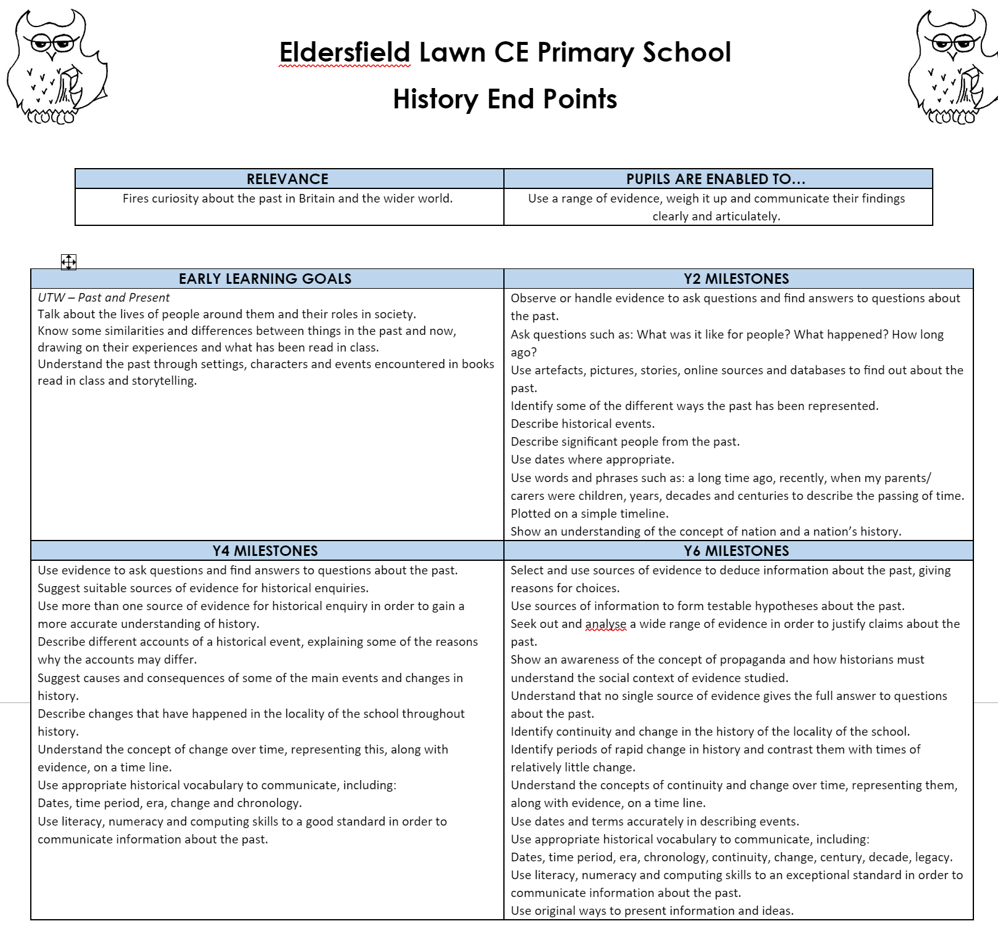

Slide 11
Proverbs 22:6
Start children off on the way they should go, and even when they are old they will not turn from it.

Slide 12
Embed a lifelong love of learning
Define the intent of the school's curriculum
  Agree this with all stakeholders
  The curriculum must relate to pupils' lives, learning activities must engage their natural curiosity and assessments must measure real accomplishments.
Expose children to a range of opportunities across all areas of the curriculum giving context to their learning
  Visitors, visits, business, agencies.
Use children's questioning to define their learning.
Give children the skills and moral framework to become future citizens.

Slide 13
1 Timothy 6:18-19
Instruct them to do good, to be rich in good works and to be generous and ready to share, treasuring up for themselves a firm foundation for the future, so that they may take hold of that which is truly life.

Slide 14
Summary quote
We must never underestimate the responsibility that we, as educators, have for the children within our care. Never forget the impact that you have upon their future. These young people are not consumers of facts, but rather creators of knowledge. Our role as teachers is to know each pupil as an individual in order to comprehend his or her unique needs, learning style, social and cultural background, interests and abilities. In doing this we are able to provide a purposeful, moral and lasting education.

