Slide 1
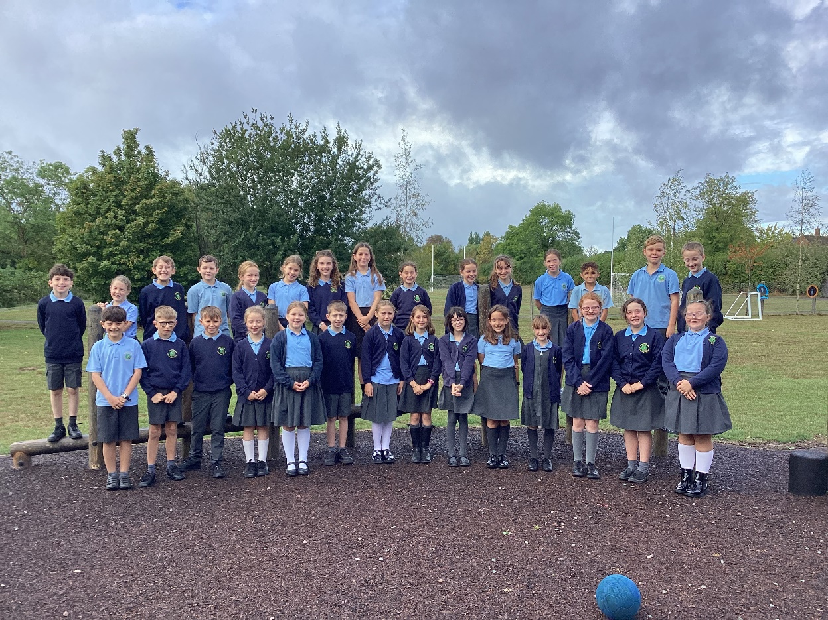
Welcome to Class 4’s Curriculum Evening.
Teachers: Mrs Carolan (Monday, Tuesday, Wednesday pm).
Mrs George (Wednesday am, Thursday, Friday)
Mrs Evans and Mrs Phelps - TAs

Slide 2
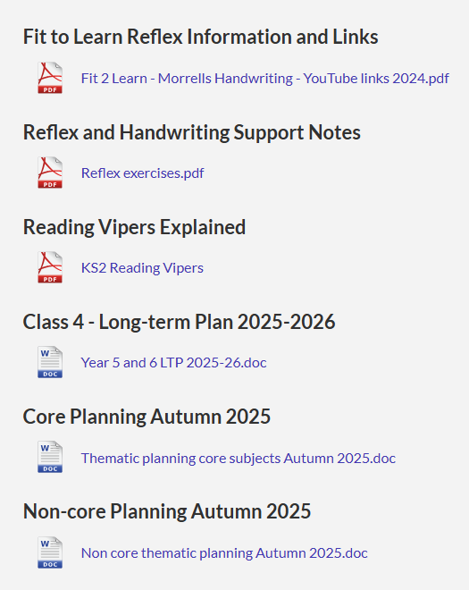
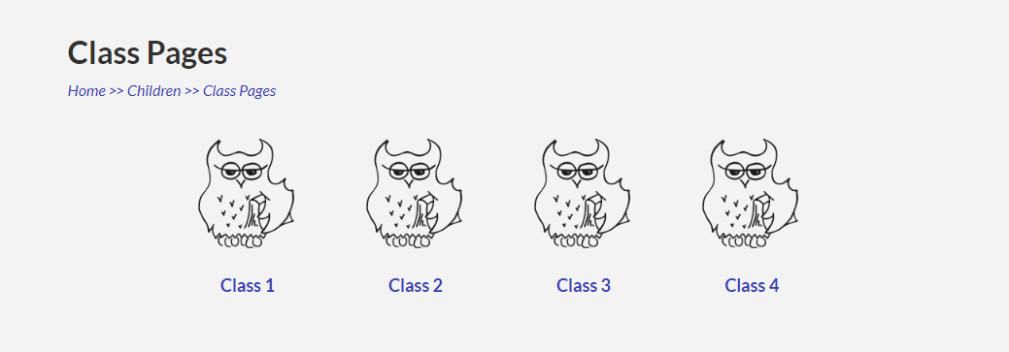
School Website
Please could you check information daily before phoning the school.
https://www.eldersfieldlawn.worcs.sch.uk/
Class 4 Page (We will upload photos).
Using email for correspondence (paperless).

Slide 3
Housekeeping
Emails before 8.15am - ecarolan@eldersfieldlawn.worcs.sch.uk
(Monday, Tuesday) sgeorge@eldersfieldlawn.worcs.sch.uk (Wednesday,Thursday,Friday)
Curriculum Web– on Year 4 class page
PE Kit – In school at all times. Trainers for outdoor use and warm tracksuit please. Swimming kit on Thursday
Start of School – 8.35am spellings/tables practise. Please be prompt.
End of school - 3.15pm.
Healthy Snacks –Fruit only please. Water to drink.
Absence Request –Via the school office and Head- teacher

Slide 4
Uniform
Uniform – smart, shirts tucked in.
Labelled – label jumpers
Girls – hair tied back. Stud earing only.
Boys – neat haircuts.
Shoes - Comfortable black shoes that are waterproof.

Slide 5
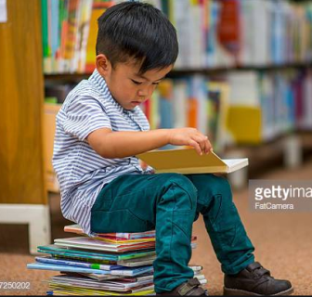

Reading - 20 minute Pledge
The school will read to your child for at least 10 minutes a day.
Can you match it at home please?
The single biggest impact you can have on your child’s education is listening to them read. Please use the questions at the front of their reading record to help you (reading Vipers).
Please fill in and sign your child’s reading record. The children will be asked to bring their reading record into school everyday and it will be checked on Friday. Every 5 signatures, children receive a raffle ticket for the monthly non-uniform draw.

Slide 6

Topmarks – daily 10
Multiplication/Division - Tables test on Friday
https://www.topmarks.co.uk/maths-games/daily10

Slide 7
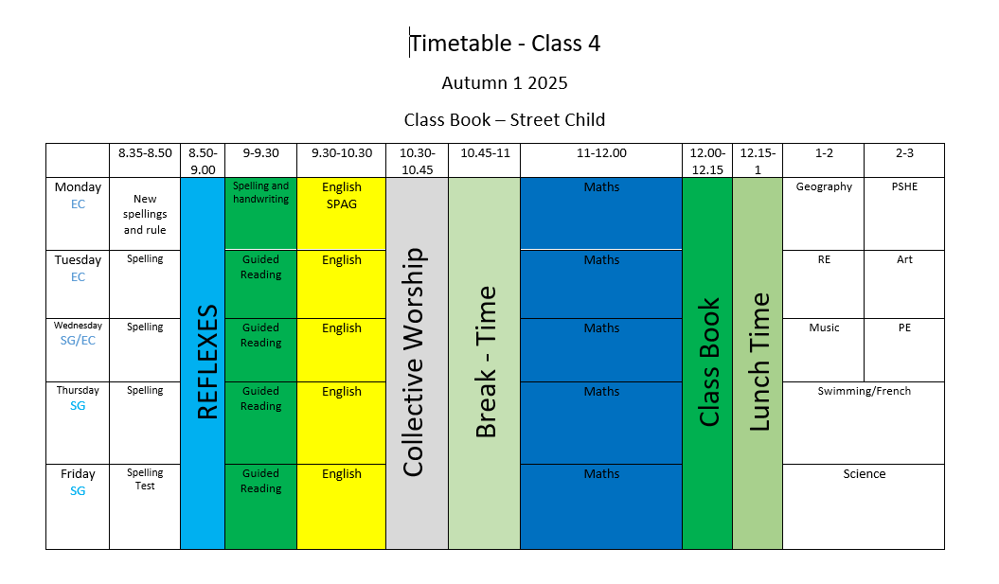

Slide 8
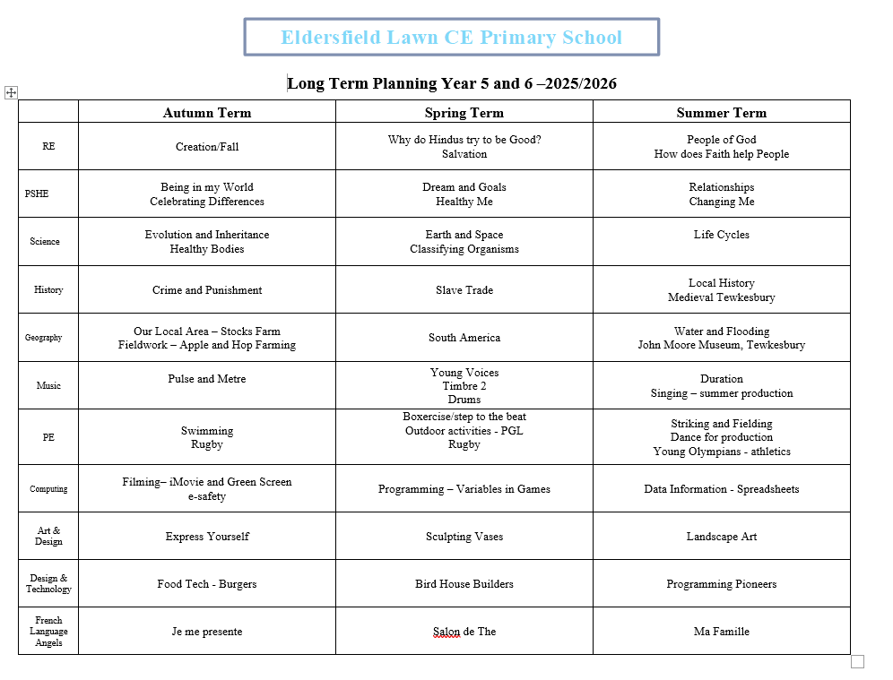

Slide 9
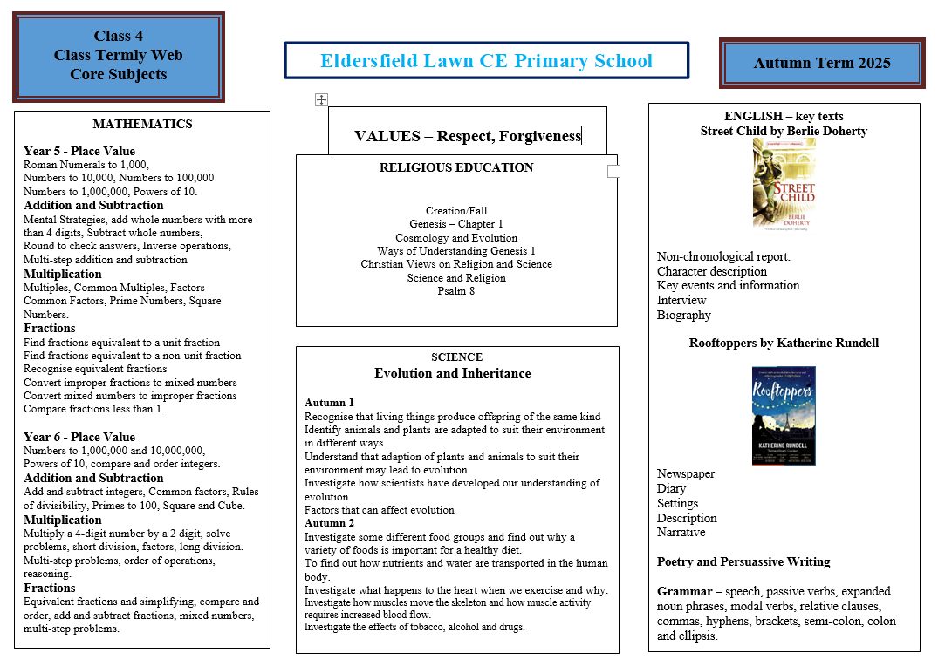

Slide 10
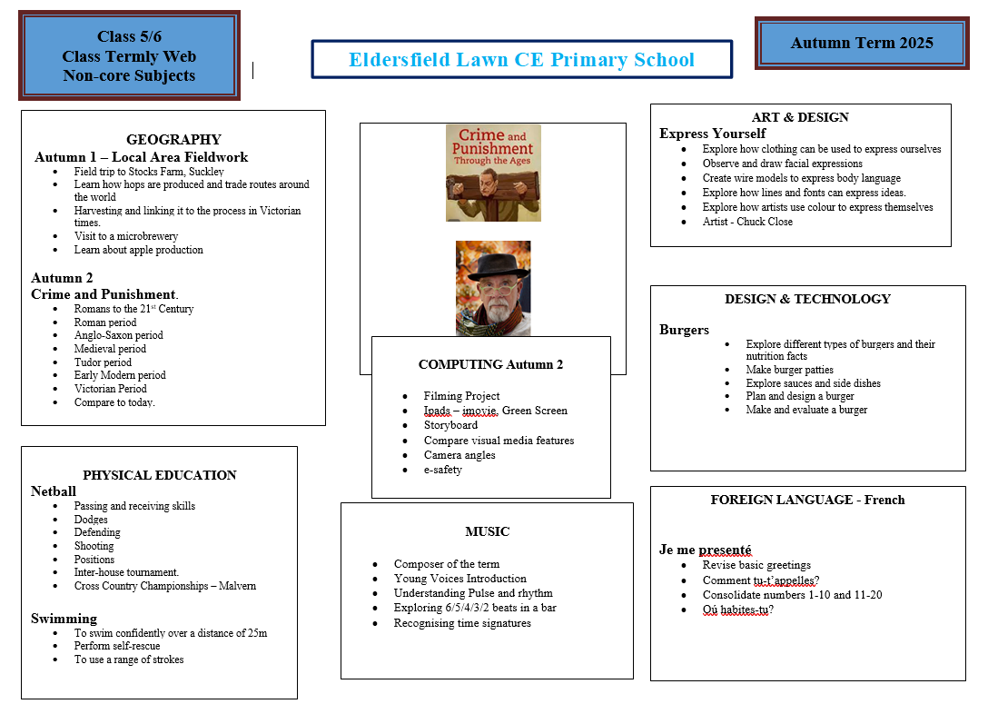

Slide 11
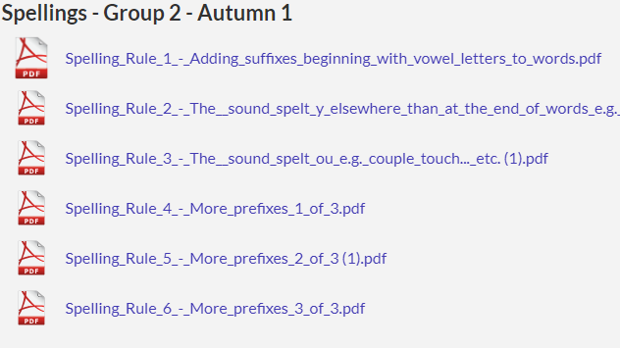
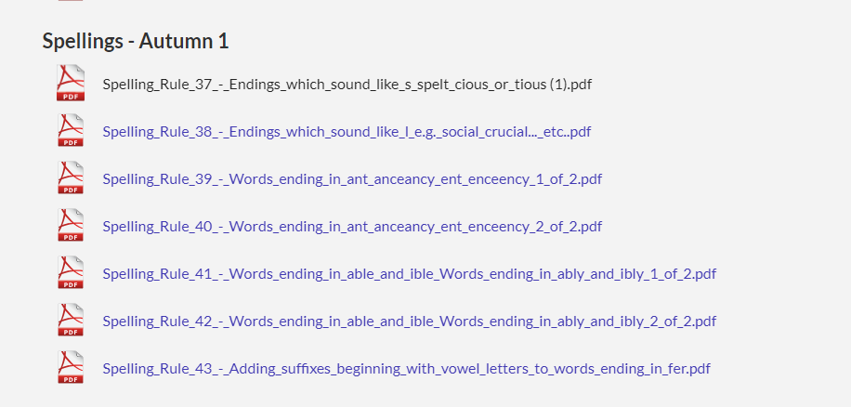
Spellings
Spelling rule input – Monday
Activities throughout the week – 08.40am
Spelling test every week (5 spellings)
Spellings on class page

Slide 12

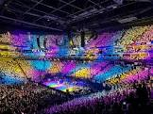
Trips
Malvern Cross Country – Friday 3rd October.
Stocks Farm – apple and hop farm. Tuesday 30th September 2025.
Young Voices (Jan).
PGL
London

Slide 13

Diary Dates
Class 4 Remembrance Service – Tuesday 11th November – 9am in school hall. Coffee afterwards.
Harvest Festival – Wednesday 8th October 2025 - 9am Eldersfield Church
Coffee afterwards. Collection – Air Ambulance.
Parents Evenings – Wednesday 8th October 1pm-4.30pm
Thursday 9th October 3.30pm-5.30pm

Slide 14

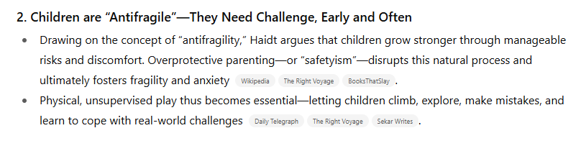
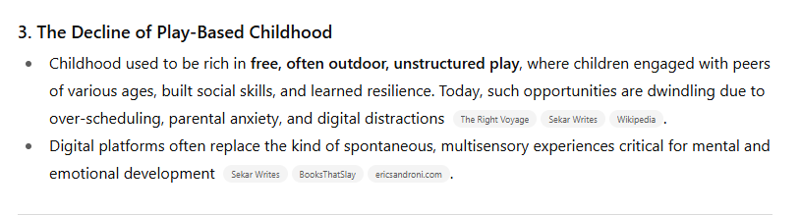
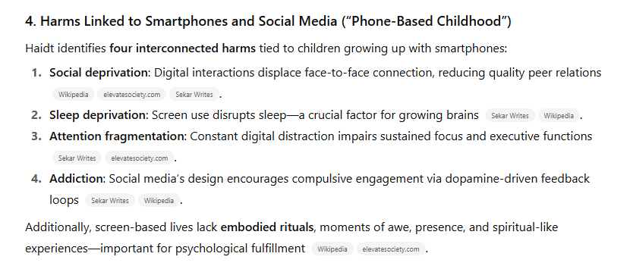
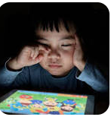

Slide 15
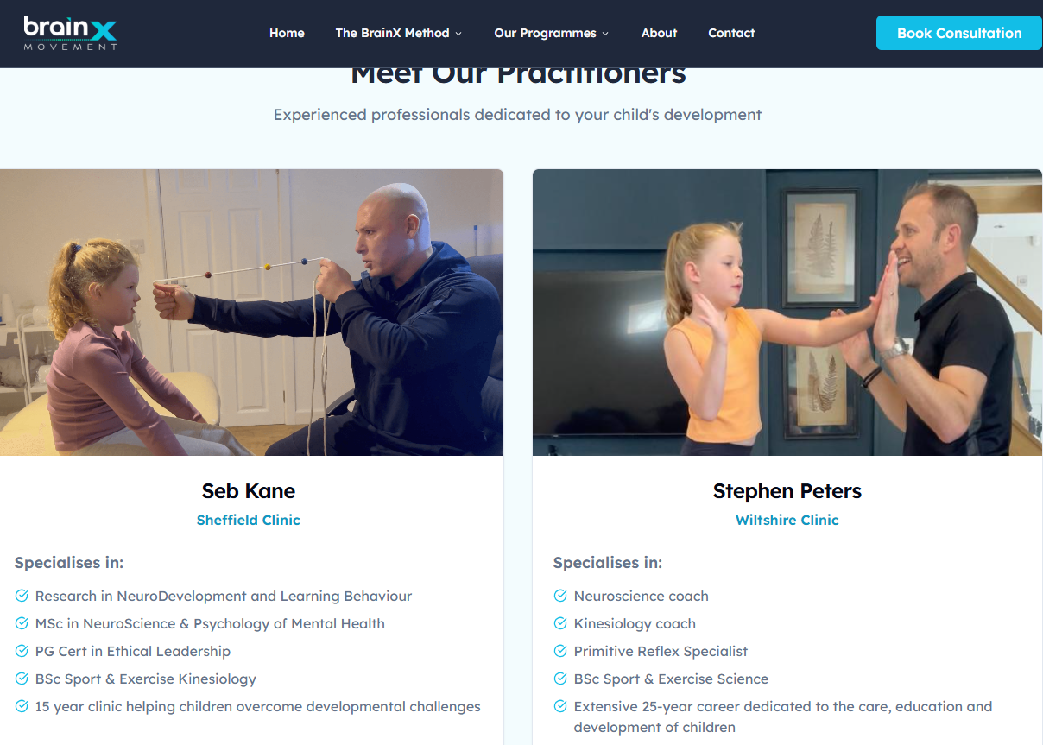
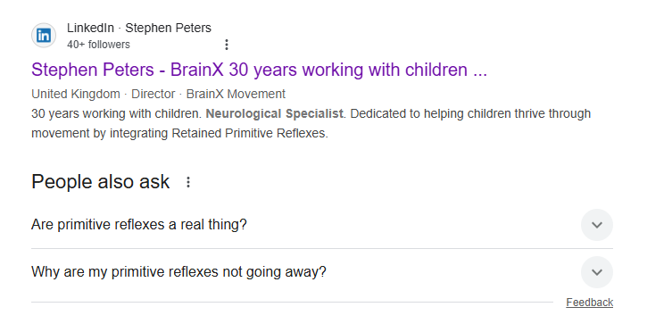

Primitive Reflexes
https://www.brainxmovement.com/

Slide 16
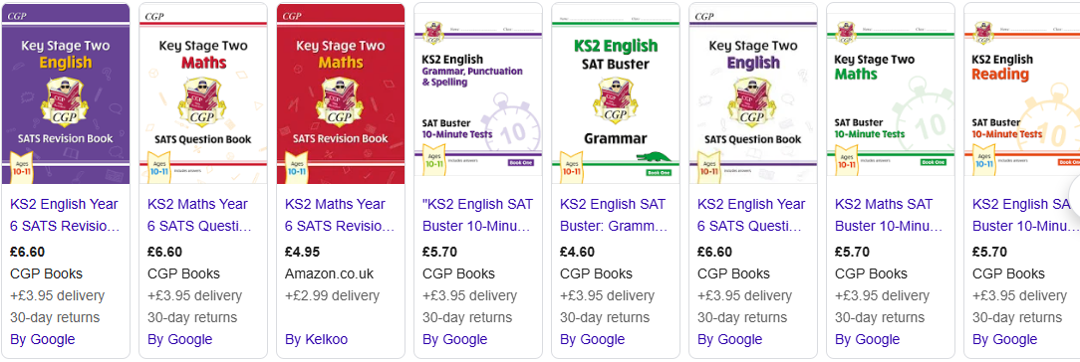
SATs 2026
Monday 11th May – Thursday 14th May 2026
Monday 11th – English grammar, punctuation and spelling.
Tuesday 12th – English Reading
Wednesday 13th – Maths
Thursday 14th – Maths
Homework will commence after Christmas.

Slide 17

Concerns
Please email us straight away
Both parents’ and children's worries are important.
Please do not leave it – however small.

Slide 18
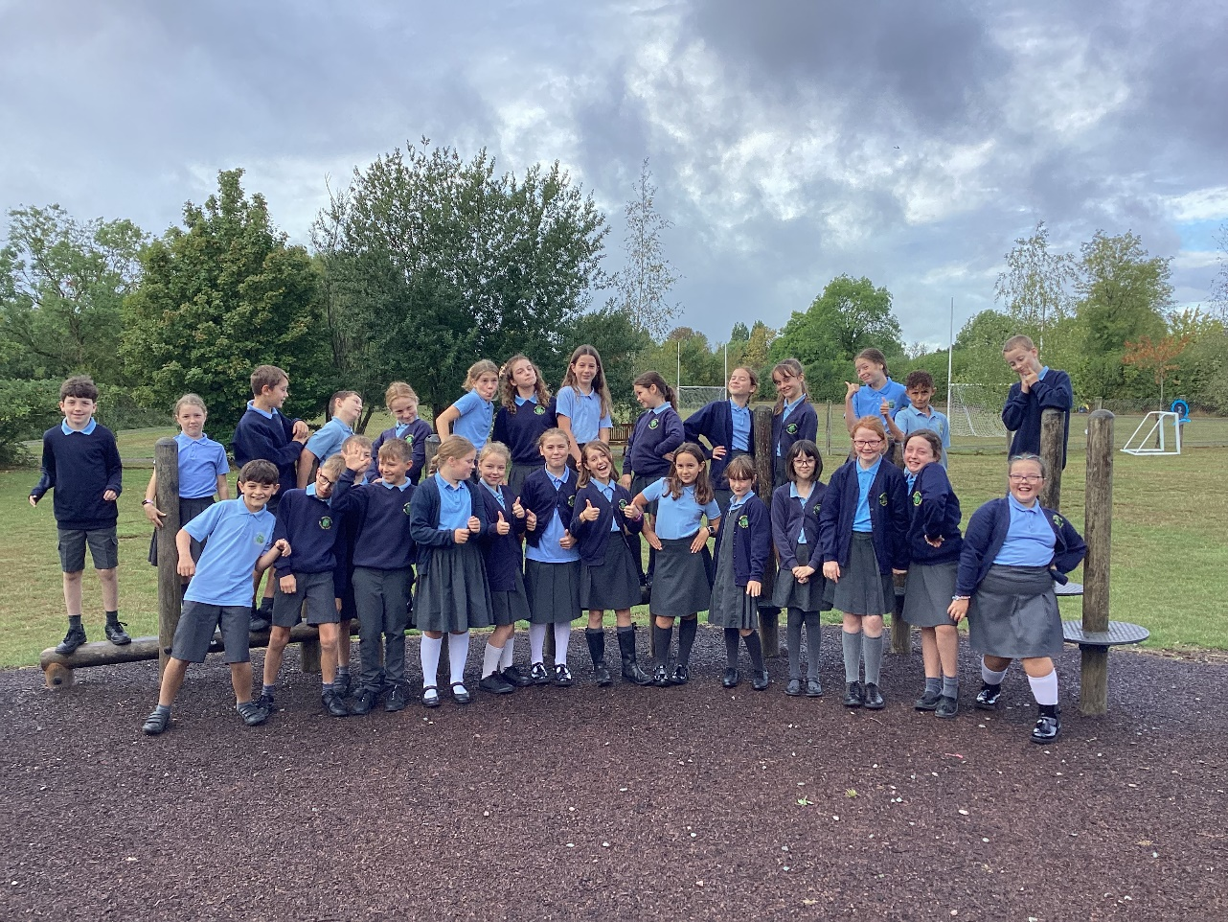
Any questions?
Thank you and we look forward to teaching your children and getting to know them.

